Slide 1
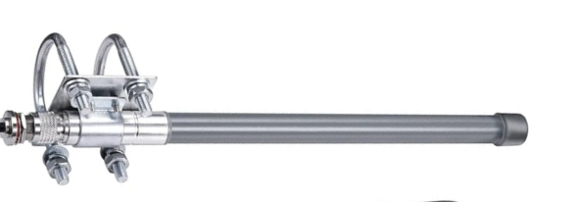
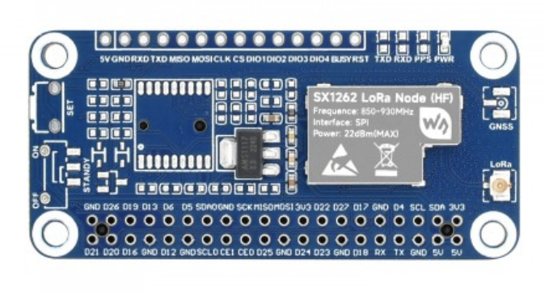
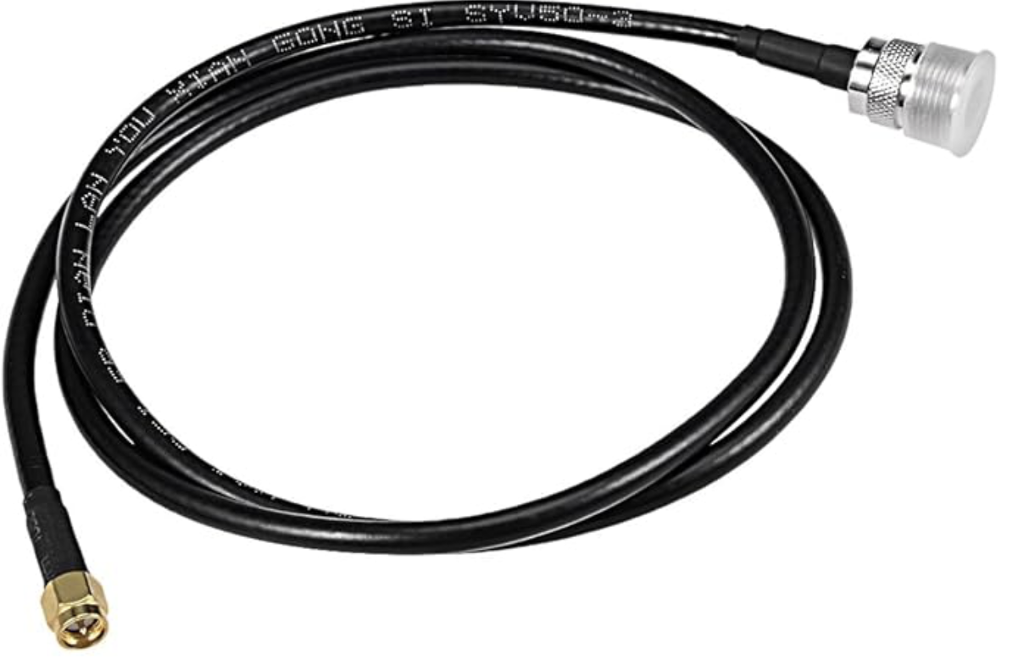
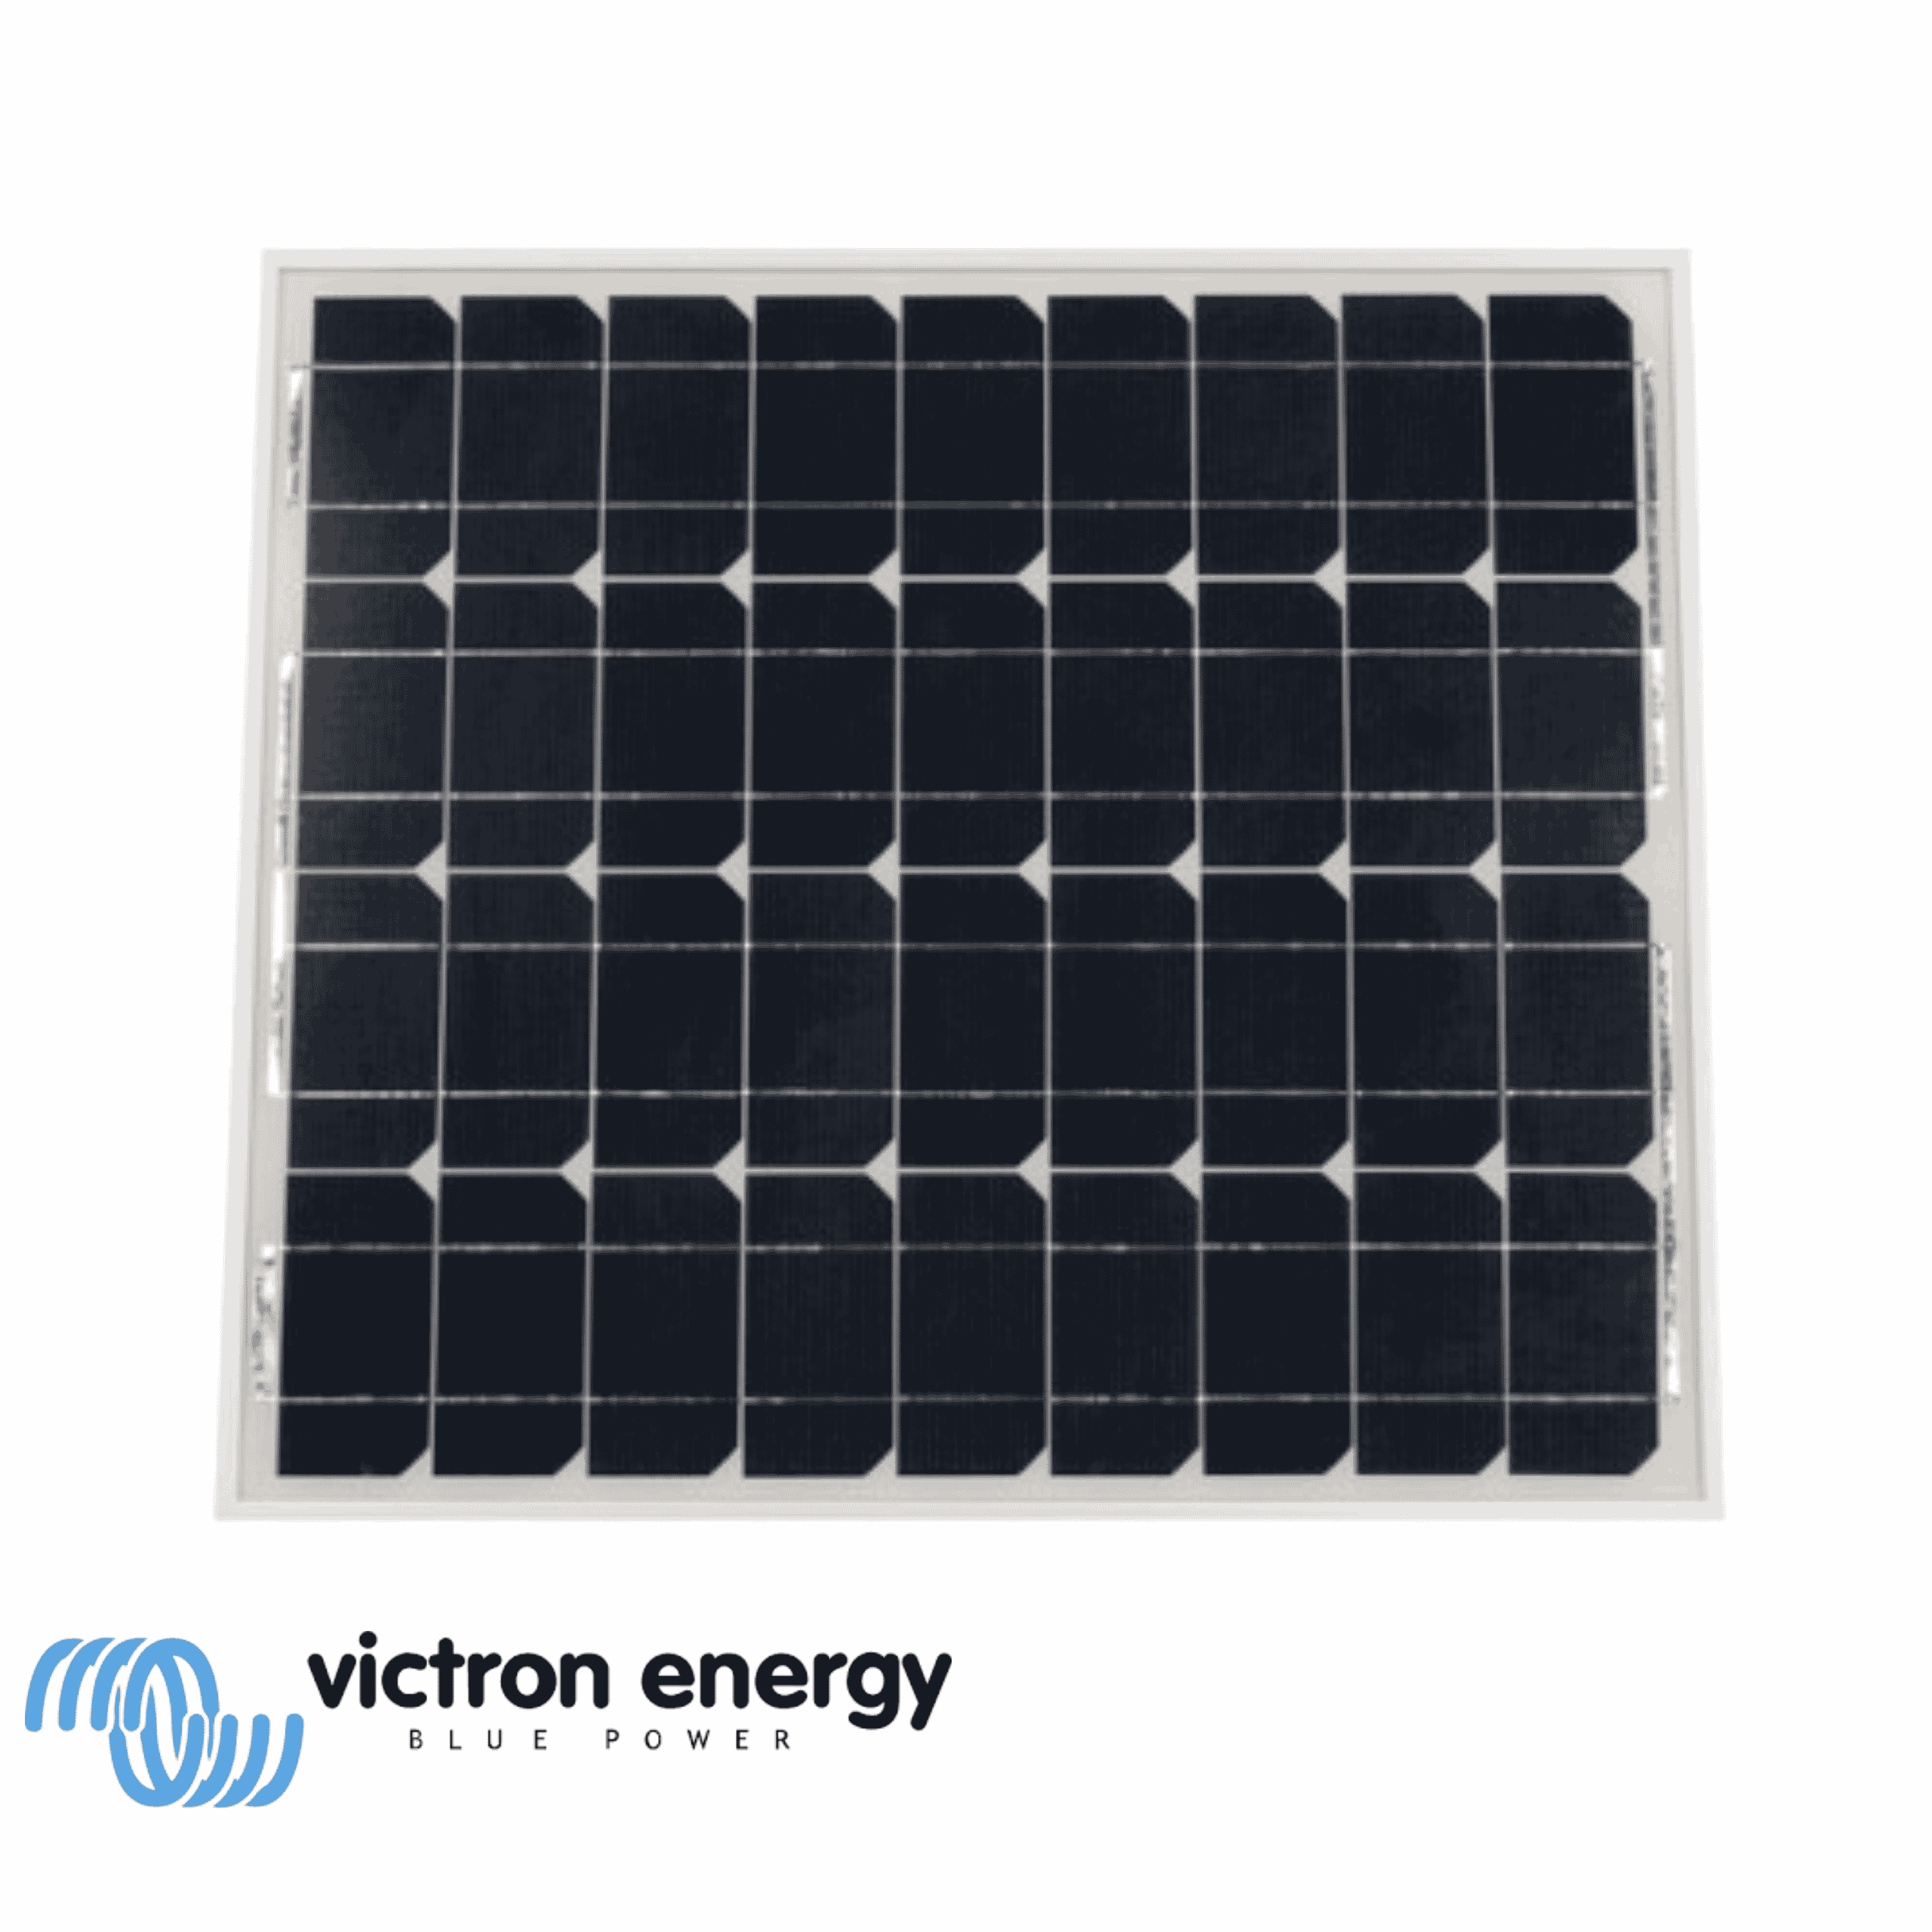
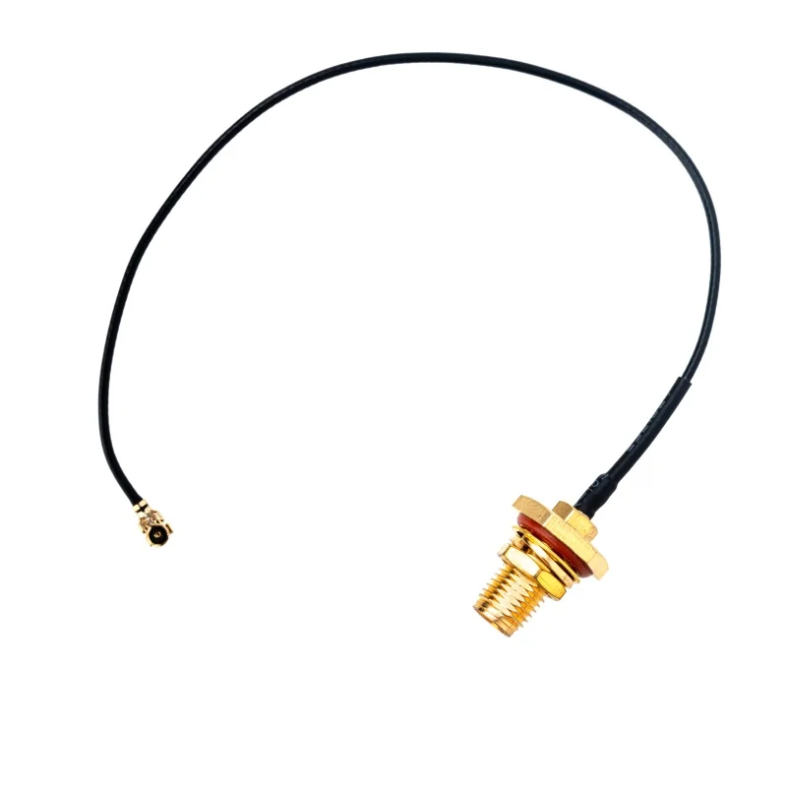
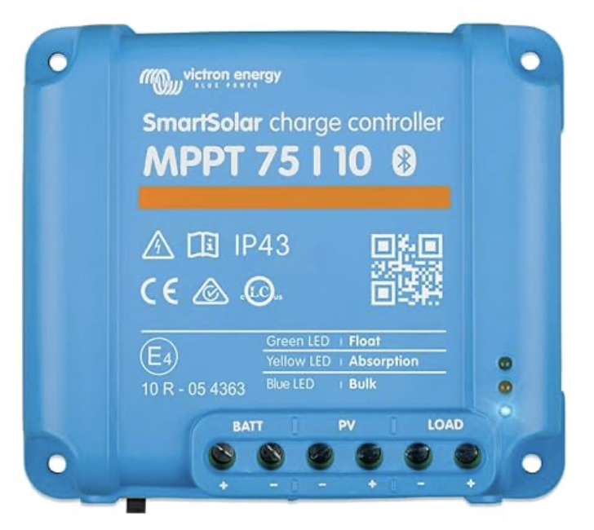
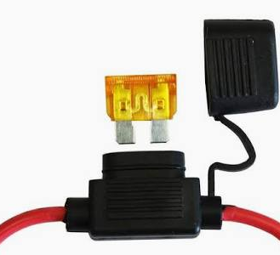
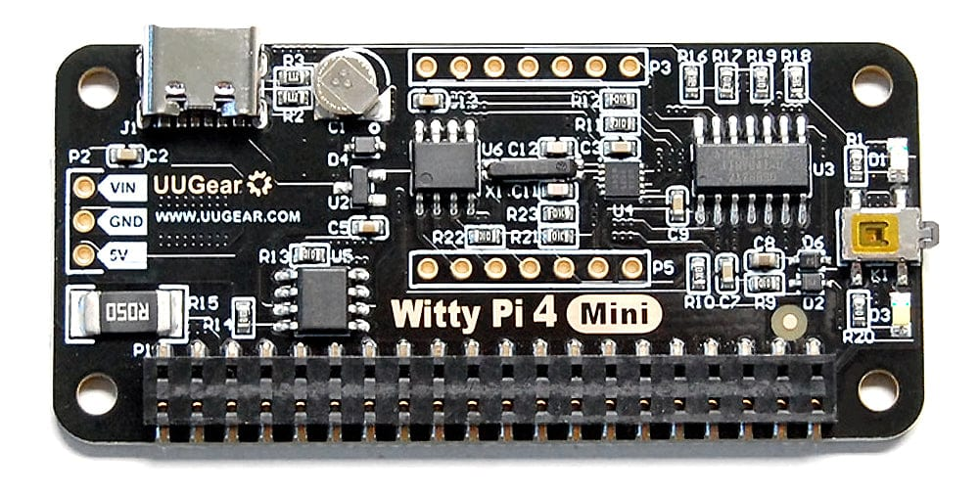
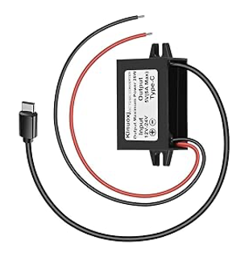
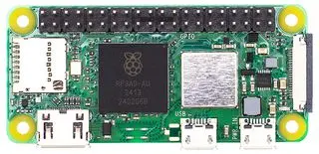
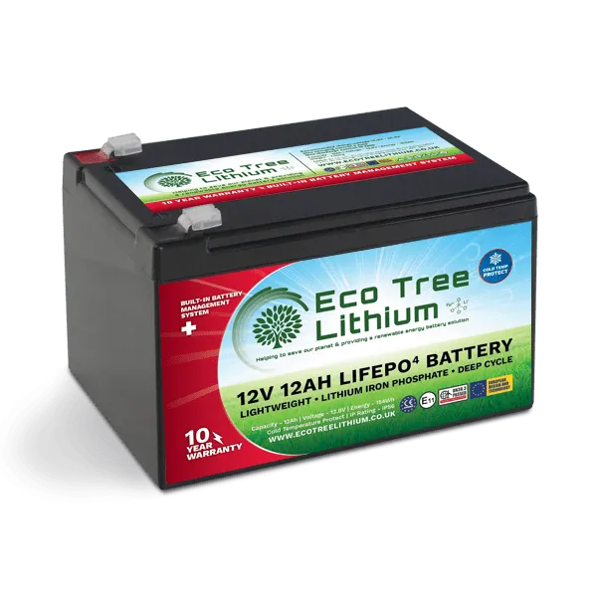
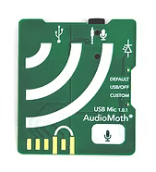
Cables
Panel to MPPT: 4mm² Solar Cable (for UV resistance)
MPPT to Battery: 6mm² or 10mm² (to minimize voltage drop)
Battery to DC Jack: 1.5mm² or 2.5mm² (standard thin wall auto wire)
Fuse
5A or 10A to protect board in case of short / cows chewing cables
Ensure all negative wires meet at the battery post or a common bus bar. This prevents ground loops which can interfere with LoRa radio.

